Slide 1


Slide 2
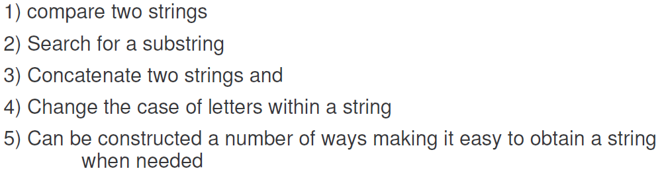
Java Provides a Class named String to create strings.
This class has various methods to:

Slide 3


Slide 4
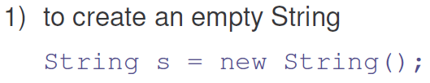

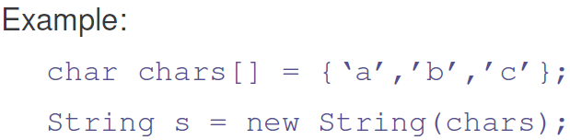
String class has several constructors as below:
Create a String with characters
String s= new String (“This is a new String”);

Slide 5


Slide 6

Write a Program to demonstrate the String creation
class MakeString
{
public static void main(String args[ ])
{
char c[ ] = {'J', 'a', 'v', 'a'};
String s1 = new String(c); //Create a string using char array
String s2 = new String(s1);
System.out.println(s1);
System.out.println(s2);
}
}

Slide 7
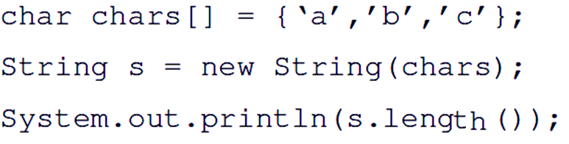
Write Java statements to print length (number of chars held by a String 0bject)
This can be obtained using length() method of String class as shown below:

Slide 8
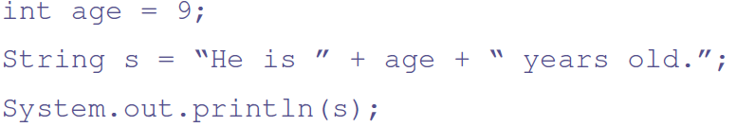

Slide 9




Slide 10

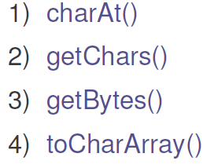
We now understand how do we extract the characters from String object
String class has following methods for char extraction
We discuss each of these…

Slide 11


How to extract a single char from String ?
e.g. ‘b’ from “abcd”?
Make use of
String s1=new String(“abcd”);
char ch1 =s1.charAt(2);//Assigns c to ch1
Similarly:

Slide 12
Consider a String "This is a demo of a String method.”
Write a Program to extract “demo” from this String
Make use of a method getChars method of a String class which is explained next….

Slide 13

: Extracts Multiple consecutive characters from String object
void getChars(int sourceStart, int sourceEnd,
char[ ] target, int targetStart)
sourceStart – specifies the index of the beginning of the substring
sourceEnd – specifies an index that is one past the end of the desired subString
target – is the array that will receive the characters
targetStart – is the index within target at which the subString will be copied is passed in this parameter
Lets see an example..

Slide 14
Consider "This is a demo of of a String method.”
How can we copy “demo” into a character Array
String s = "This is a demo of the of a String method.";//38 chars
int startIndex = 10;//Specifies the index of first char
int endIndex = 14;//One more than the last char index
char buf[ ] = new char[4];//For storing char
s.getChars( startIndex , endIndex, buf, 0);
System.out.println(buf);
What will the output??
demo

Slide 15



Slide 16
Problem statement:
Consider a string "This is a demo of a String methods";
Extract all the characters from the string object and store them into a character Array.

Slide 17

Returns all the characters of a String object. Need to store in char array.
Example:
String s = “This is a demo of a String methods";
char charAry[ ]; //Array Declared
charAry=s.toCharArray(); //Array Created and initialized
System.out.println(charAry); //char array can be printed

Slide 18

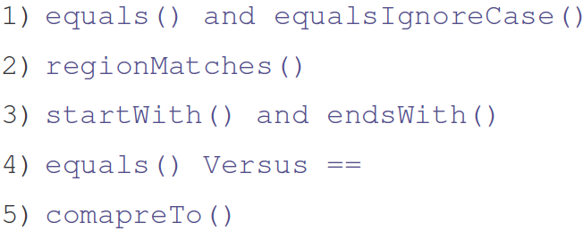
The String class includes several methods that compare strings or substrings within strings
We discuss each of these

Slide 19
It is not enough to know that two Strings are identical. You need to know which is less than, equal to, or greater than the other.
What is meant by > , <, == ?
A string is less than the another if it comes before the other in the dictionary order.
A string is greater than the another if it comes after the other in the dictionary order.
The String method compareTo() serves this purpose.

Slide 20
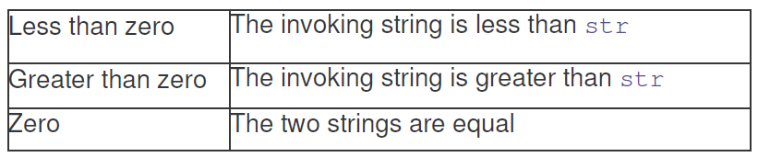
General form:
int compareTo(String str)//Case sensitive
int compareToIgnoreCase (String str)
can be used for checking ignoring case
The result of the comparison is returned and is interpreted as shown here:

Slide 21

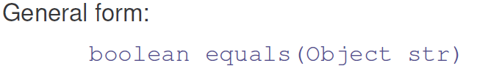
Lets see an example

Slide 22
Write a Program to compare two strings ( case sensitive and ignoring the case)
Entire content is compared

Slide 23
class equalsDemo
{
public static void main(String args[])
{
String s1 = "Hello";
String s2 = "Hello";
String s3 = "Good-bye";
String s4 = "HELLO";//ALL caps
System.out.println(s1.equals(s2));
System.out.println(s1.equals(s3));
System.out.println(s1.equals(s4));
System.out.println(s1.equalsIgnoreCase(s4));
}
}

Slide 24
Consider two strings given below:
My name is Rahul
My name is Amit
Write a program to check if the part of the strings are same (case sensitive and case insensitive)
In the above example “My name is” is same in both the strings

Slide 25
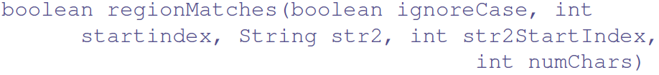
Can be done using regionMatches() method of String class
startindex – index of character in str1,
str2- object to be compared
str2startindex - – index of character in str2
numChars – number of characters to be compared
ignoring the case of characters
Lets see the program in the next slide…

Slide 26
startindex – index of character in str1,
str2- object to be compared
str2startindex - – index of character in str2
numChars – number of characters to be compared
Lets write the Program statements:
String str1= new String (“My name is Rahul”);
String str2= new String (“ My name is Amit”);
boolean compare=str1.regionMatches(0, str2, 0, 10);
System.out.println(compare);

Slide 27





Slide 28

equals() method compares the characters inside a String object.
2) == operator compares two object references to see whether they refer to the same instance
Lets see an example:
Write a program to compare contents to two string objects

Slide 29
class EqualsNotEqualTo
{
public static void main(String args[])
{
String s1 = "Hello";
String s2 = new String(s1);
System.out.println(s1.equals(s2));//TRUE
System.out.println((s1 == s2));//False
}
}

Slide 30
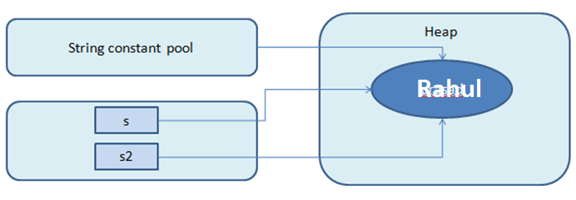
Some discussion on String comparison
String can be created using String literals:
String s = “Rahul";
String s2 = “Rahul";
System.out.println(s == s2); // true
However this method of comparison should be avoided
Use
boolean b=s.equals(s2)

Slide 31
Using the constructor of String Class
String s1=new String (“abc”); //Object 1
String s2=new String (“abc”); //Object 2
Separate memory allocated for each object.
boolean b=s1.equals(s2)

Slide 32
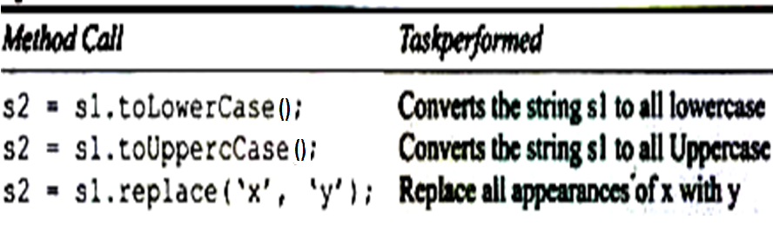



Slide 33



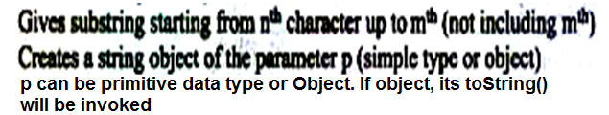



Slide 34

Methods like following do not change the original String object but they return the new object by constructing a new String.
1) subString(n,m)
2) concat(s2)
3) replace(‘x,’y’)
4) trim()

Slide 35
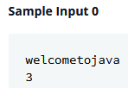
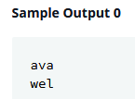
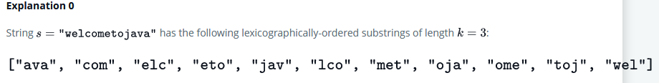
Problem Statement (HackerRank) (NetBeans helloworld/StringSubString)
Given a String
extract the substrings of length “k”, where k is an int
order them in Lexicographical order and
Print the first and last substring
Explanation as below..

Slide 36
Lets understand the steps involved
Read the string and size of sub string from the user
Extract all possible sub strings from given string
Order them Lexicographically (sort)
Print the first and last substring

Slide 37
import java.util.*; //Scanner class class TestClass
{
{ public static void main (String args[ ]) {
//Read String and size of sub string Scanner sc=new Scanner( System.in ); System.out.println( "Enter the string“ ); String input= sc.nextLine();
System.out.println("Enter size of substring"); int subSize=sc.nextInt();

Slide 38
/* Extract substrings based on value of subSize
We do not know how many sub strings would be generated */
String concat=“ "; //Create concatenated string
int i=0; // Value of i provides no. of sub strings
for ( i=0; i<=input.length() - subSize; i++) { //extract sub string from i, to subSize //Use conact to create the sub strings separated with
space
concat+= input.substring(i, subSize +i )+ " ";
//NOTE: here “ “ is a separator
}

Slide 39
// Copy substrings from concat to String array
String sArray[ ]=new String [ i ]; // i provided no. of substrings
// Scanner extracts substrings (token) based on “ “ as separator
Scanner scStr=new Scanner( concat ); int j=0; while( scStr.hasNext() ) //are there more tokens { sArray[ j ++] =scStr.next(); //extract token }

Slide 40
//Sort the array Lexicographically. i provides no. of substrings for(int k = 0; k < i-1; ++k) { for (int l = k + 1; l < i; ++l) { if (sArray[k].compareTo(sArray[l]) > 0) { String temp = sArray[k]; sArray[k] = sArray[l]; sArray[l] = temp; } } }
// Print the first and last substring System.out.print(sArray[0]+ " "+sArray[i-1]); } //end of main } //end of class

Slide 41
Lets Achieve the same using Java library classes
import java.util.*; //SortedSet and TreeSet classes
class SubStr
{
public static void main(String[ ] args)
{
Scanner scan=new Scanner(System.in);
String str=scan.next();
int k=scan.nextInt();
SortedSet<String> sets=new TreeSet<String> ();
for(int i=0; i<=str.length()-k; i++)
{
sets.add( str.substring (i, i+k) );
}
System.out.println(sets.first());
System.out.println(sets.last());
}//end of main
} //end of class

Slide 42
Write a program to print all the
Uppercase,
Lower Case and
digits present in the given string
e.g. “My Address is 566/6, Bell Road”
One of the important wrapper class is Character in java.lang package.
which has various static methods that help in understand the String object,
Lets see the various methods….

Slide 43
String str1=new String("My Address is 566/6, Bell Road");
//Check each char for letter or digit
char c=str1.charAt(0);
boolean b=Character.isLetter(c);//Letter or not?
//If true then check is it upper or lower
boolean b=Character.isUpperCase(c); //or
//Similarly…
c=str1.charAt(1);
b=Character.isLowerCase(c);
System.out.println(b);
//Check for digit
c=str1.charAt(14);
b=Character.isDigit(c);
System.out.println(b);
//Neither letter nor digit means special char…

Slide 44
Can we concatenate the objects with string?
We can !! We need to add the “toString()” method ( that converts instance variables to String) to the class
This method automatically gets invoked while concatenation.
We can add the following method to the Class Box that we have seen:
public String toString() //Method returns string
{
return "Dimensions are " + width + " by " + depth + " by " + height + ".";
}
As shown in the next slide:

Slide 45
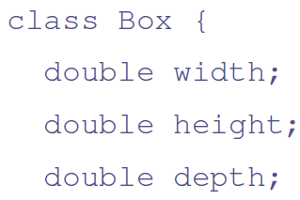
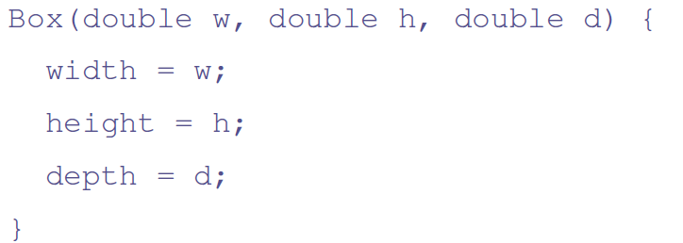

Slide 46
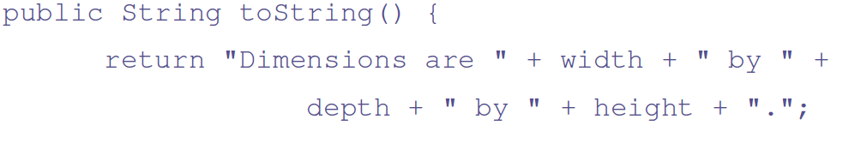


Slide 47
class toStringDemo
{
public static void main(String args[ ])
{
Box b = new Box(10, 12, 14);
String s = "Box b: " + b; // concatenate Box object
System.out.println(b); // convert Box to string
System.out.println(s);
}
}
What is the output??
Dimensions are 10.0 by 30.0 by 20.0.
Box b: Dimensions are 10.0 by 30.0 by 20.0.

Slide 48
If we do not include the “toString()” method in Box class, then what will be printed.
helloworld.Box@9931f5 // This is the Object ID
Box b: helloworld.Box@9931f5
Note:
Since all the Classes are sub-classes of “Object” class, of API, the toString() of Object is invoked. toString() constructs the object id as:
getClass().getName() + '@' + Integer.toHexString(hashCode())

Slide 49

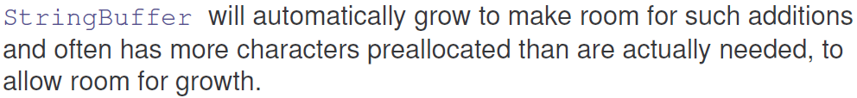

Slide 50

3) StringBuffer(String str) – accepts a String argument that
initially sets the content of the StringBuffer Object and reserves room for 16 more characters without reallocation.

Slide 51

Current length of a StringBuffer can be found via the length() method, while the total allocated capacity can be found through the capacity() method.
Lets see the example

Slide 52
class StringBufferDemo
{
public static void main(String args[])
{
StringBuffer sb = new StringBuffer("Hello");
System.out.println("buffer = " + sb);
System.out.println("length = " + sb.length());
System.out.println("capacity = " + sb.capacity());
}
}// The output will be :
buffer = Hello
length = 5
capacity = 21

Slide 53
if you know in advance that you will be appending a large number of small strings to a StringBuffer
Use ensureCapacity() to allocate more memory
void ensureCapacity(int minimumCapacity)
After using the above method, the new capacity is the larger of
The minimumCapacity argument and Twice the old capacity, plus 2.
StringBuffer s1=new StringBuffer();
System.out.println(s1.capacity());//16
s1.ensureCapacity(37);
System.out.println(s1.capacity());//37
StringBuffer s1=new StringBuffer();
System.out.println(s1.capacity());//16
s1.ensureCapacity(17);//less than 34
System.out.println(s1.capacity());//34
16*2+2=34

Slide 54
void setLength(int newLength)
Sets the length of this String buffer.
Lets see an example to understand the difference between setLength() and ensureCapacity()
StringBuffer buf = new StringBuffer("0123456789");//10 char +16
buf.setLength(5); // buf now contains "01234"
buf.setLength(10); // buf now contains "01234" followed
by five null characters
Note: However in this case the capacity is still 26

Slide 55



Slide 56

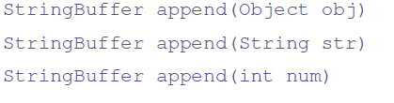
Example:
int a = 42;
StringBuffer sb = new StringBuffer(40);
String s = sb.append("a = ").append(a).append("!").toString();
System.out.println(s);
Output: a = 42!
Note: When stored chars exceeds the capacity, capacity it is increased to (old capacity*2)+2

Slide 57

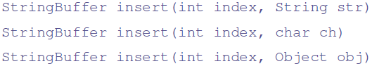
Here, index specifies the index at which point the String will be inserted into the invoking StringBuffer object.
Example:
StringBuffer sb = new StringBuffer("I Java!");
sb.insert(2, "like ");
System.out.println(sb);

Slide 58

Example:
StringBuffer s = new StringBuffer("abcdef");
System.out.println(s);
s.reverse();
System.out.println(s);//Output fedcba

Slide 59


Slide 60
Exercise
1. What is the length and capacity of the following :
StringBuffer sb = new StringBuffer("Able was I ere I saw Elba.");
2. Consider the following string:
String hannah = "Did Hannah see bees? Hannah did.";
What is the value returned by the method call hannah.charAt(12)?
3. Show two ways to concatenate the following two strings together to get the string "Hi, mom.":
String hi = "Hi, ";
String mom = "mom.";

Slide 61
Output Formatting:
Basic formatting can be achieved using PrintStream object. “System.out” as follows
int i = 461012;
System.out.format("The value of i is: %d%n", i); //%n is newline
Double d= 3.142567745;
System.out.format(“Value of d is: %.3f%n", d); //3 decimal digits
Customized formatting can be done using class java.text.DecimalFormat as given below:
DecimalFormat nf1 = new DecimalFormat("00000E00");
String f1 = nf1.format(1187654.321);
System.out.println(f1);//Output 11877E02 More? Homework

Slide 62
Wrapper Classes:
Wrapper classes convert the primitive data types into objects.
Integer, Double, Float, Character, Boolean, Byte, Short etc..
Helps in Storing and retrieving using Java API classes like “Stack”
Integer.toString(a);//Converting int a to String object
Long.parseLong(str);//Converting string str to long
Double.valueOf(str);//Converts string to double object
We look at an example that makes use of Stack class.

Slide 63
Stack class can be used for storing objects including that of user classes
import java.util.Stack;
class StackTest
{
public static void main(String[] args) throws Exception
{
Stack<Integer> mystack=new Stack<Integer>();
Integer iObj=new Integer(10);
mystack.push(iObj);//Stores object
mystack.push(20);//AutoBoxing
int sum=iobj.intValue()+mystack.peek();//Unboxing (peek)
System.out.println(mystack.pop());
System.out.println(mystack.pop());
System.out.println(mystack.pop());//Runtime error EmptyStack
}
}

